Slide 1
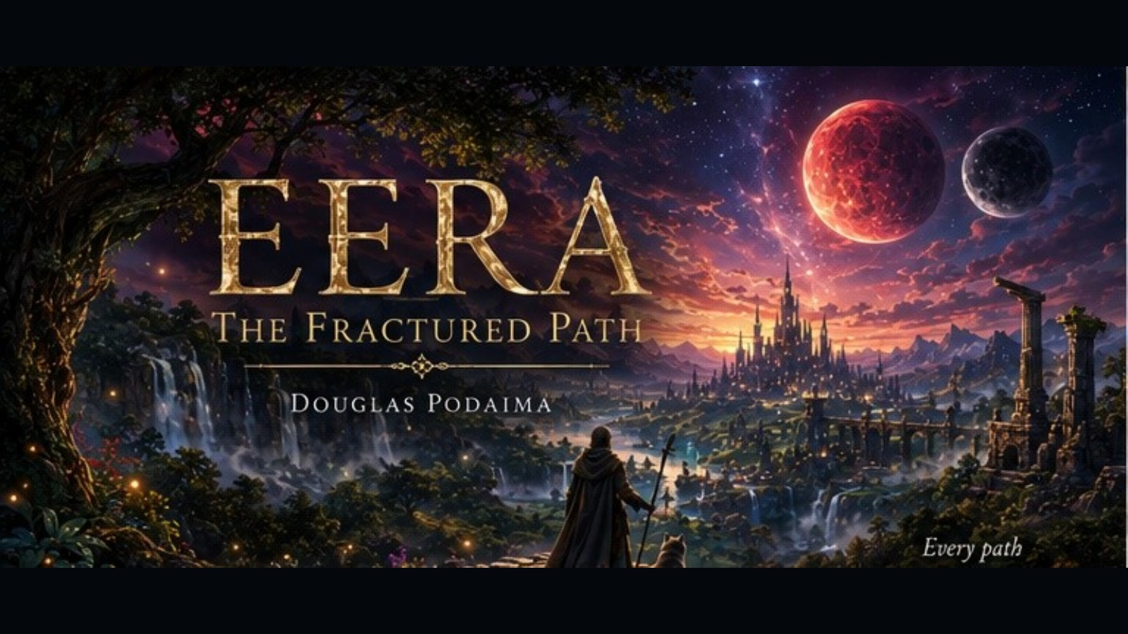
A fantasy adventure about prophecy, courage, identity, and the choices that shape who we become.

Slide 2
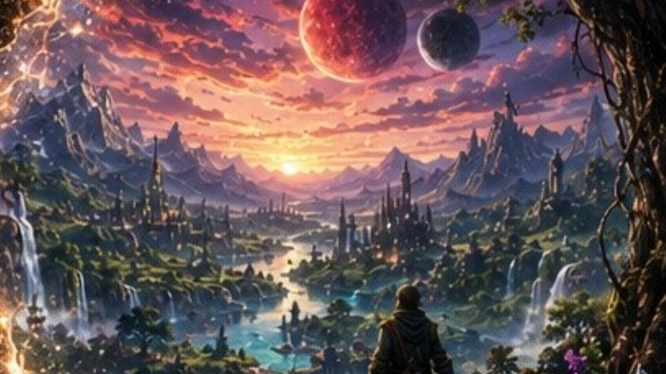
AUTHOR STORY
More Than Forty Years in the Making
Born from an idea that began decades ago, Eera grew into a complete fantasy world of moons, ancient roads, hidden powers, and hard choices.
A long road.
A finished world.
Douglas Podaima • Author, educator, storyteller

Slide 3
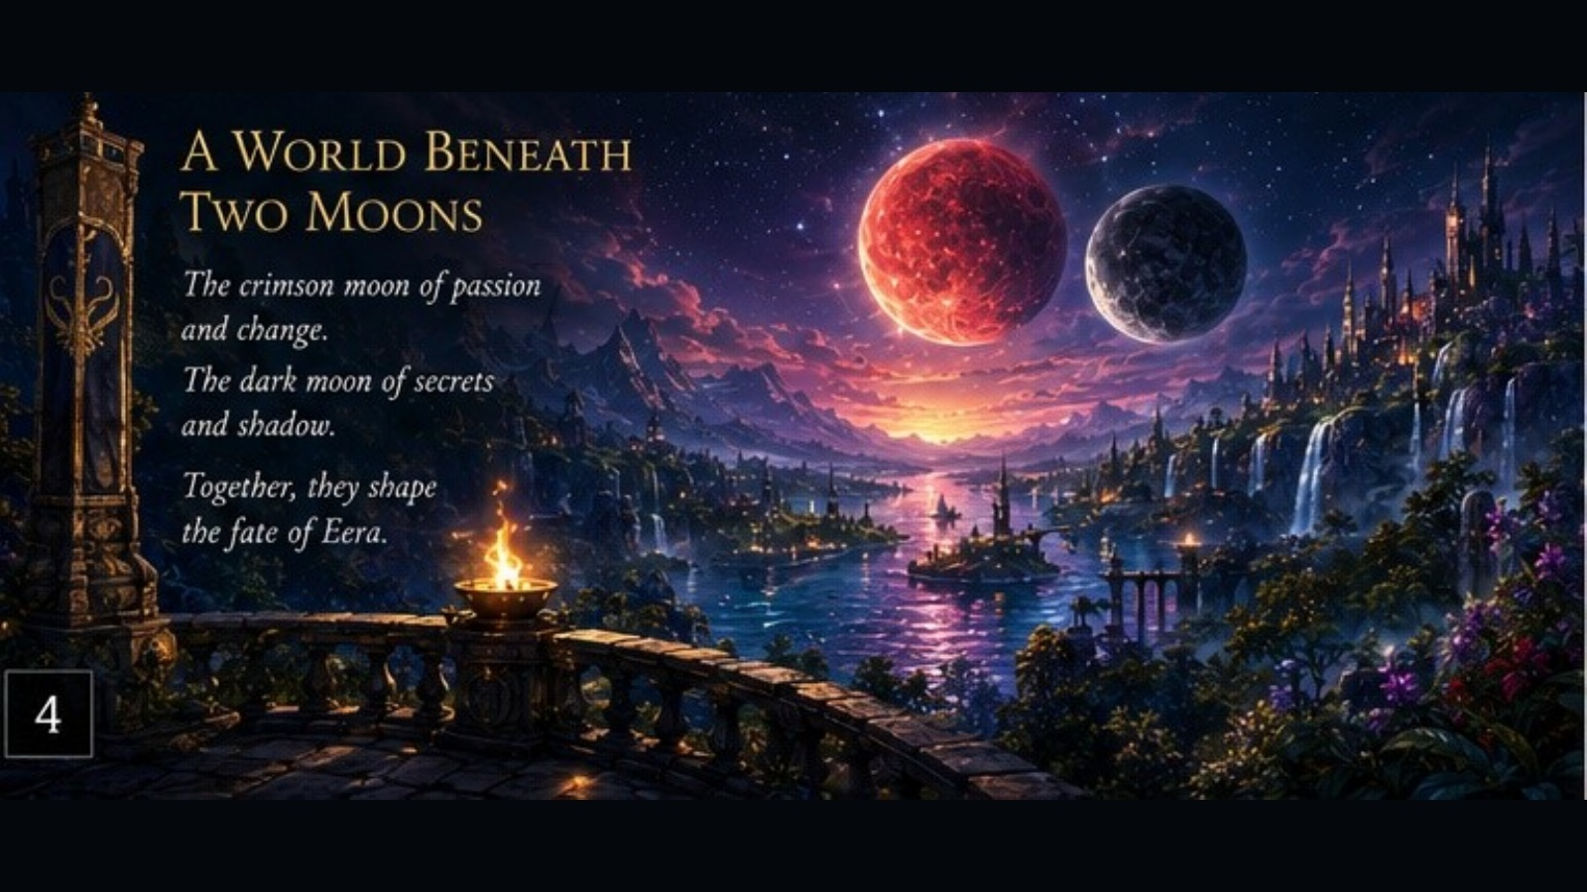
THE WORLD
A World Beneath Two Moons
The crimson moon signals passion and change.
The dark moon carries secrets and shadow.
Together, they shape the fate of Eera.
Every sky carries a warning.
Eera: The Fractured Path • Douglas Podaima • Classroom & School Presentation

Slide 4
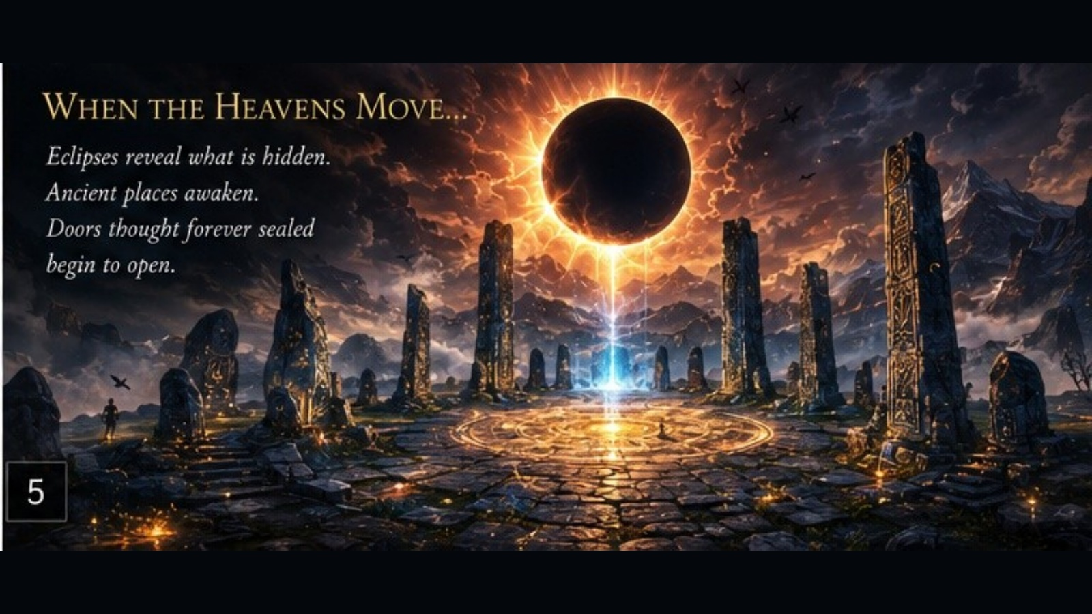
MYSTERY
When the Heavens Move
Eclipses reveal what is hidden.
Ancient places awaken.
Doors thought forever sealed begin to open.
Not every answer arrives safely.
Eera: The Fractured Path • Douglas Podaima • Classroom & School Presentation

Slide 5
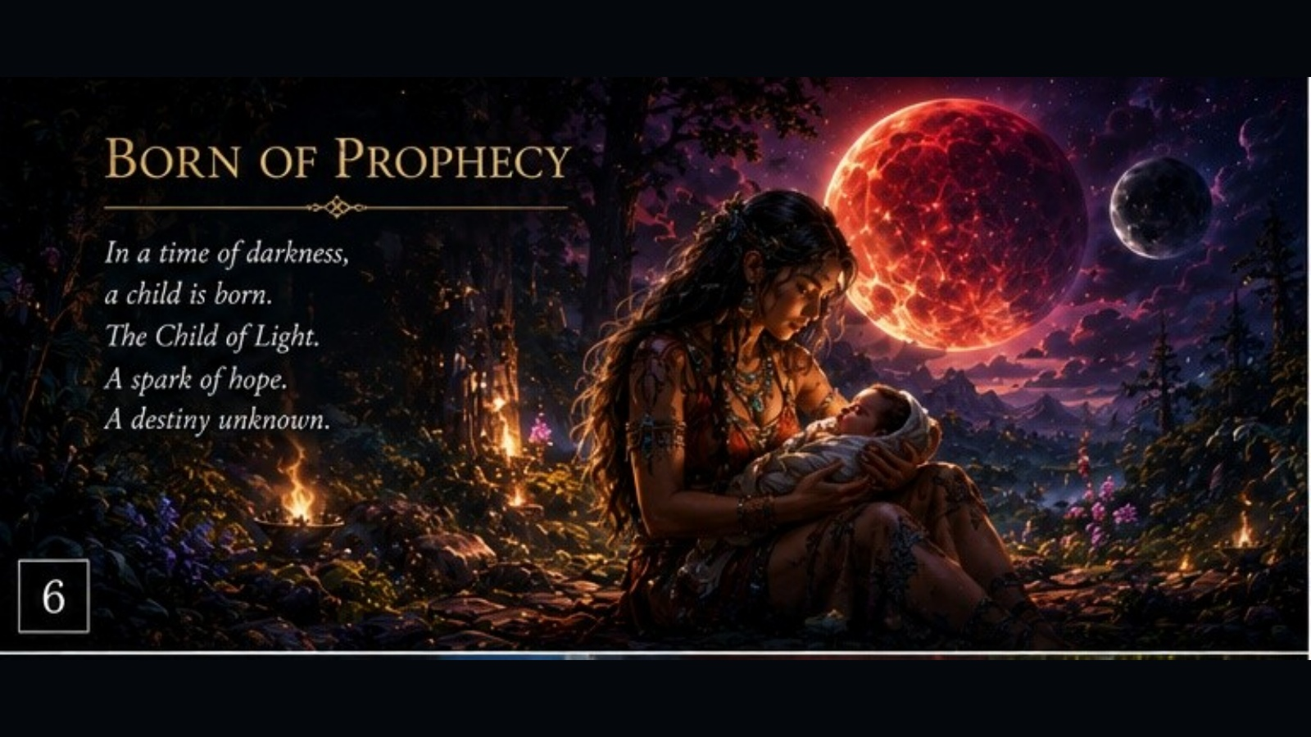
PROPHECY
Born of Prophecy
In a time of darkness, a child is born.
The Child of Light.
A spark of hope.
A destiny no one fully understands.
Hope begins quietly.
Eera: The Fractured Path • Douglas Podaima • Classroom & School Presentation

Slide 6
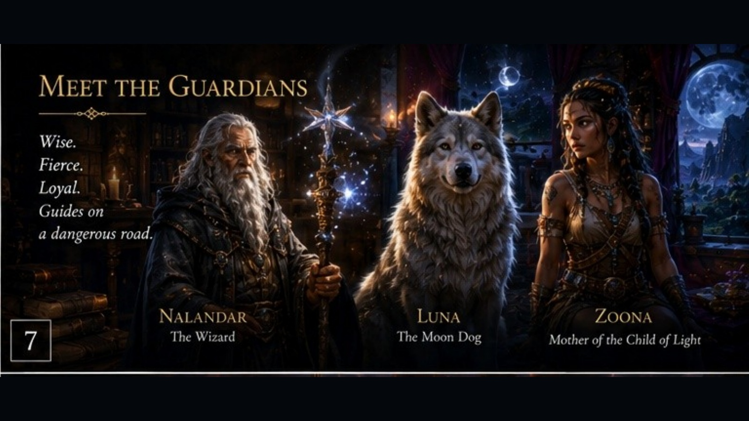
GUARDIANS
Guides on a Dangerous Road
Nalandar brings wisdom.
Luna brings instinct and loyalty.
Zoona brings courage, love, and the strength to protect what matters.
Power is not the same as purpose.
Eera: The Fractured Path • Douglas Podaima • Classroom & School Presentation

Slide 7
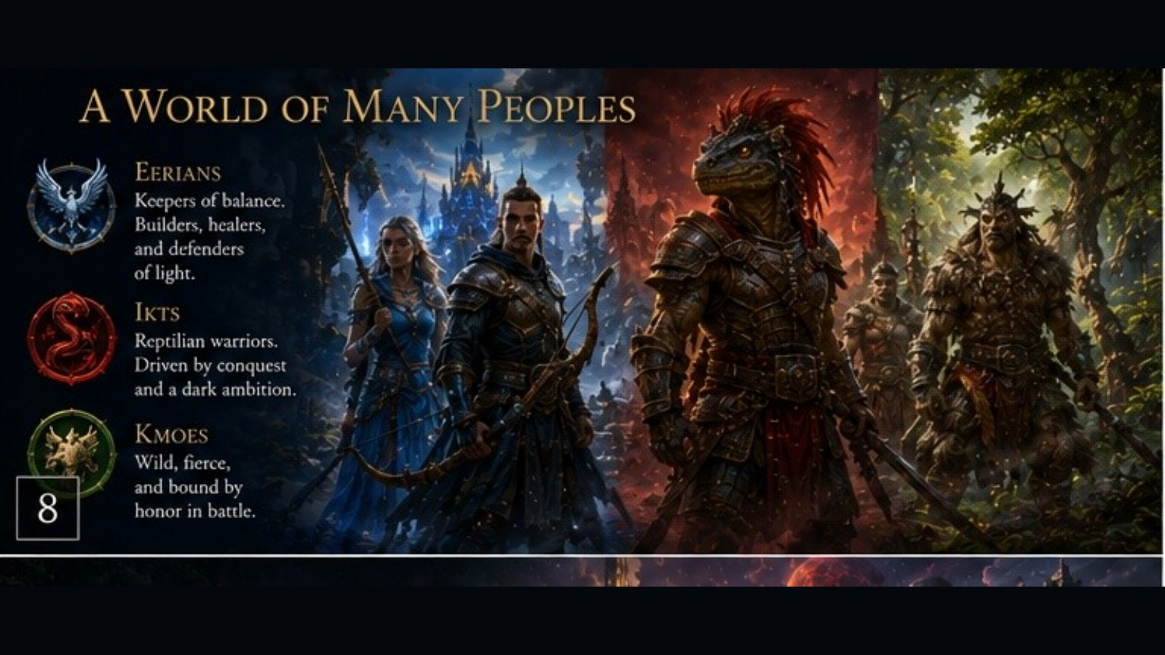
PEOPLES OF EERA
A World of Many Peoples
Eerians defend balance and light.
Ikts are shaped by duty, fear, and ambition.
Kmoes live by strength and honor.
Understanding is not the same as agreeing.
Eera: The Fractured Path • Douglas Podaima • Classroom & School Presentation

Slide 8
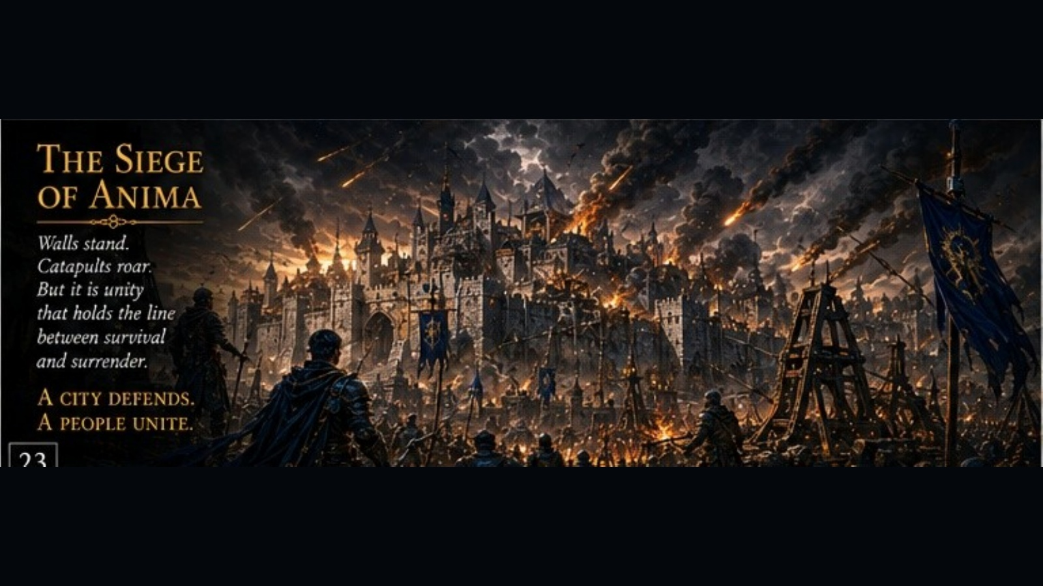
CONFLICT
War Comes to Eera
Armies march.
Cities burn.
But the deepest battles are not fought only with weapons.
A city defends.
A people unite.
Eera: The Fractured Path • Douglas Podaima • Classroom & School Presentation

Slide 9
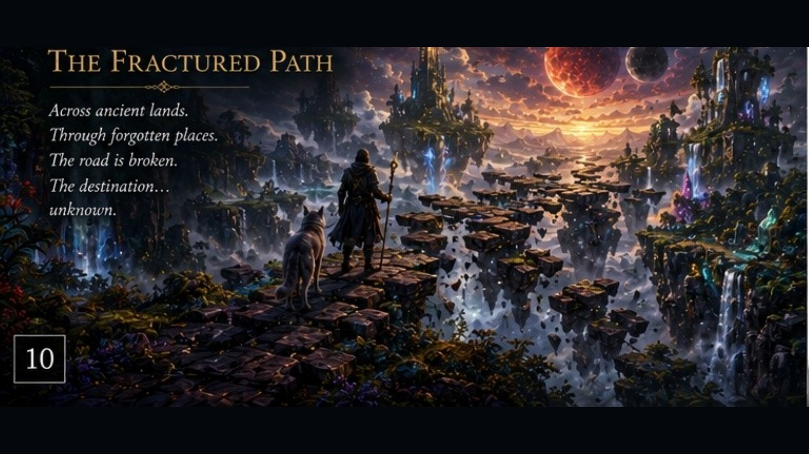
THE ROAD
The Fractured Path
Across ancient lands.
Through forgotten places.
The road is broken, the destination uncertain, and every step demands a choice.
The journey changes us all.
Eera: The Fractured Path • Douglas Podaima • Classroom & School Presentation

Slide 10
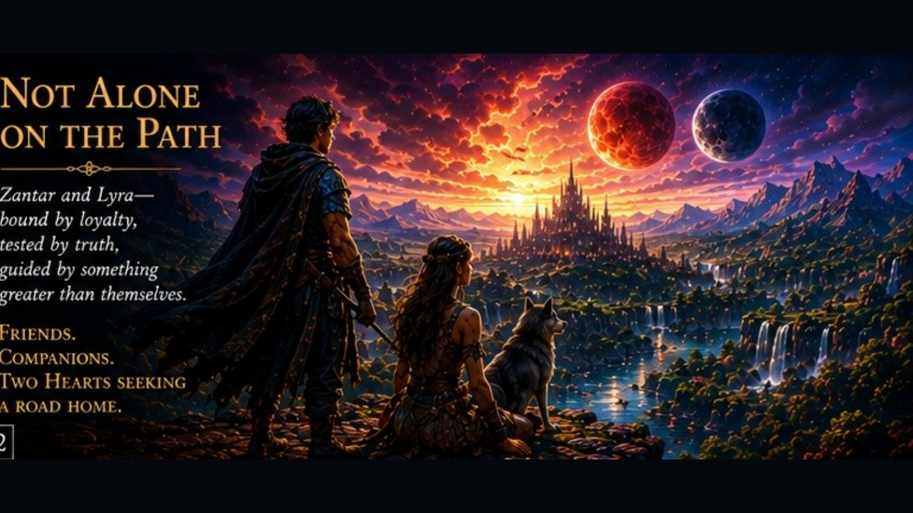
COMPANIONS
Not Alone on the Path
Loyalty.
Truth.
Courage.
Friendship and trust become as important as any sword or spell.
No one becomes whole alone.
Eera: The Fractured Path • Douglas Podaima • Classroom & School Presentation

Slide 11
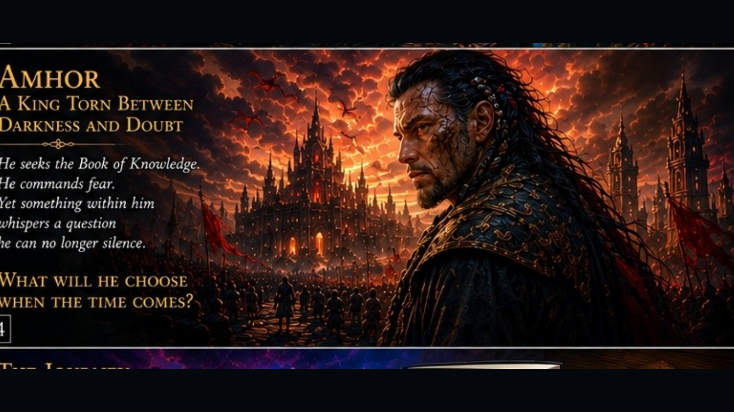
AMHOR
Darkness, Doubt, and Choice
Amhor seeks knowledge.
He commands fear.
Yet something within him begins to question the path he has chosen.
What will he become?
Eera: The Fractured Path • Douglas Podaima • Classroom & School Presentation

Slide 12
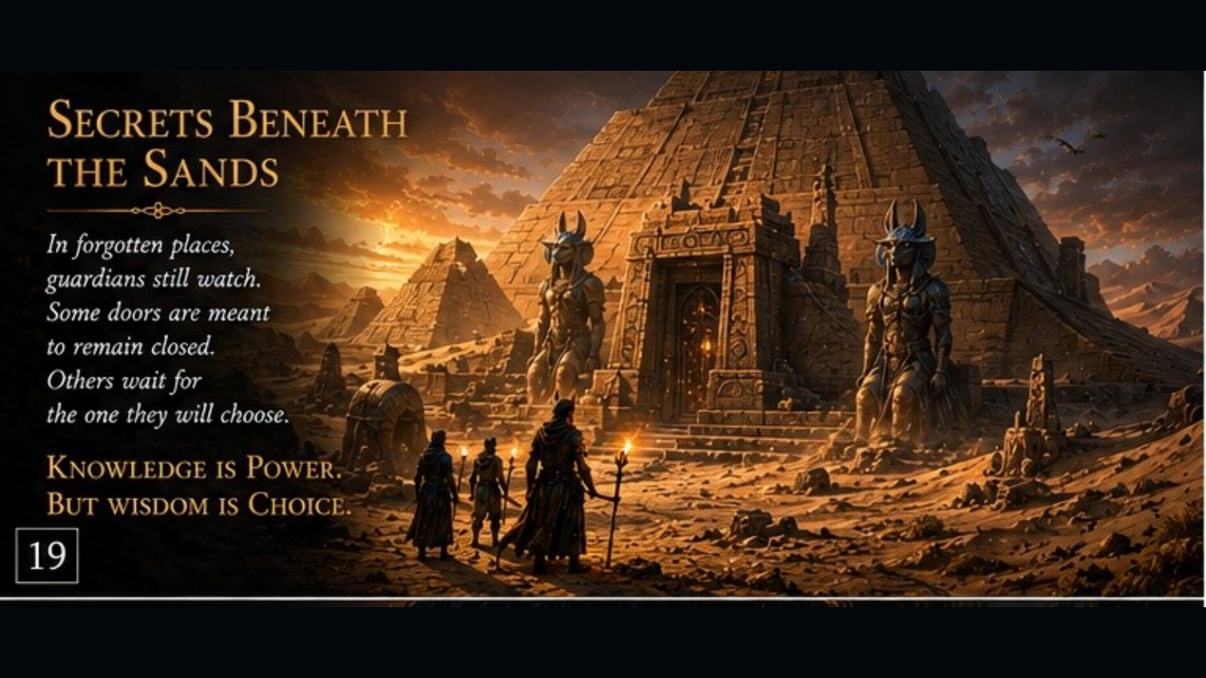
ANCIENT SECRETS
Knowledge and Wisdom
Guardians still watch.
Doors remain sealed.
Some truths are dangerous because of the hearts that seek them.
Knowledge is power.
Wisdom is choice.
Eera: The Fractured Path • Douglas Podaima • Classroom & School Presentation

Slide 13
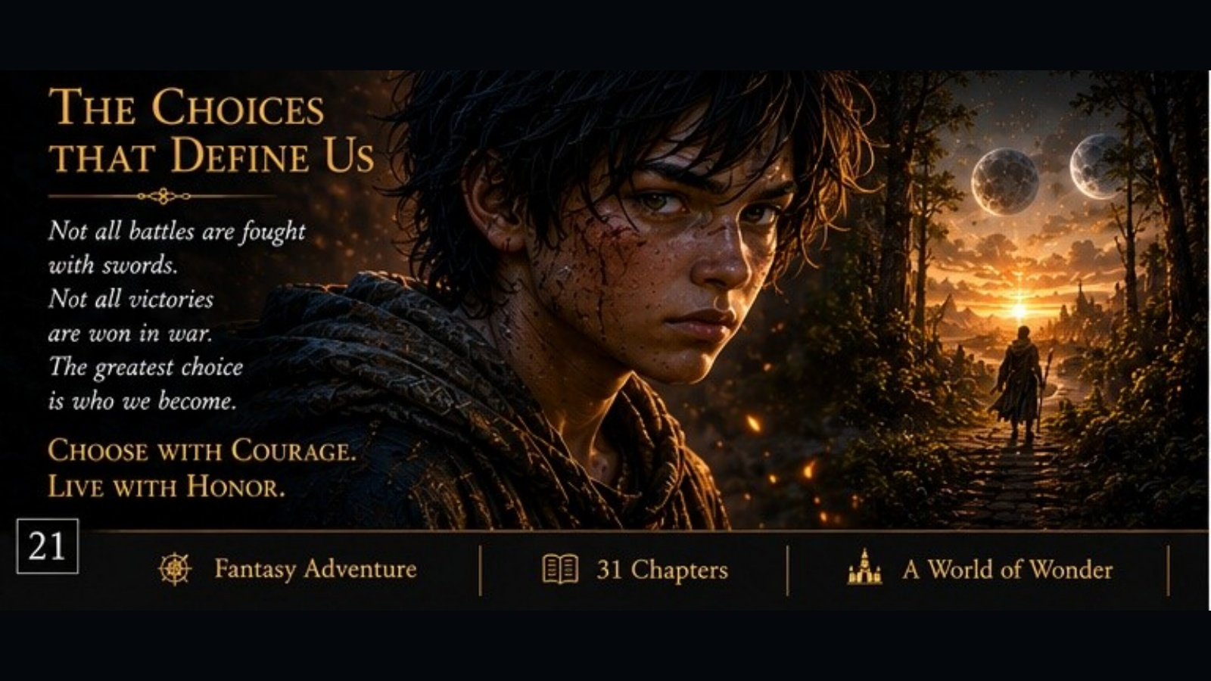
THEMES
The Choices That Define Us
Not all battles are fought with swords.
Not all victories are won in war.
The greatest choice is who we become.
Choose with courage.
Live with honor.
Eera: The Fractured Path • Douglas Podaima • Classroom & School Presentation

Slide 14
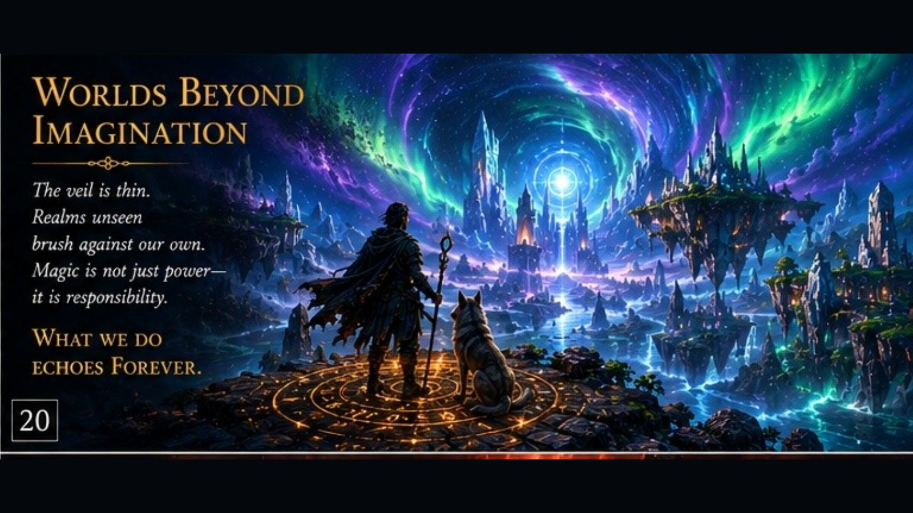
FOR SCHOOLS
A Classroom Package
Student Novel Study
Short Teacher’s Guide
Chapter-by-chapter discussion options
Themes: identity, courage, prejudice, leadership, responsibility, and choice
Built to help teachers teach, not bury them in pages.
Eera school package • Student Guide • Teacher’s Guide • Presentation

Slide 15
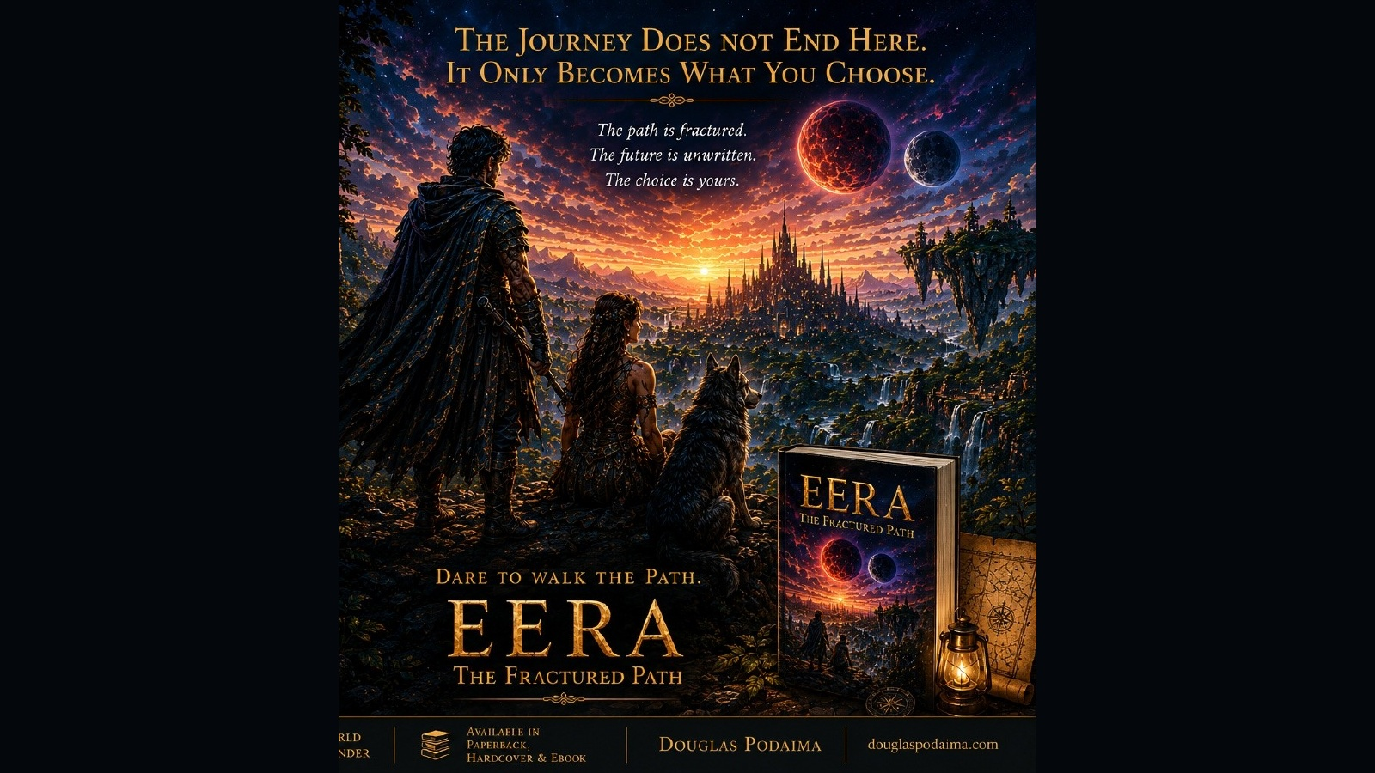
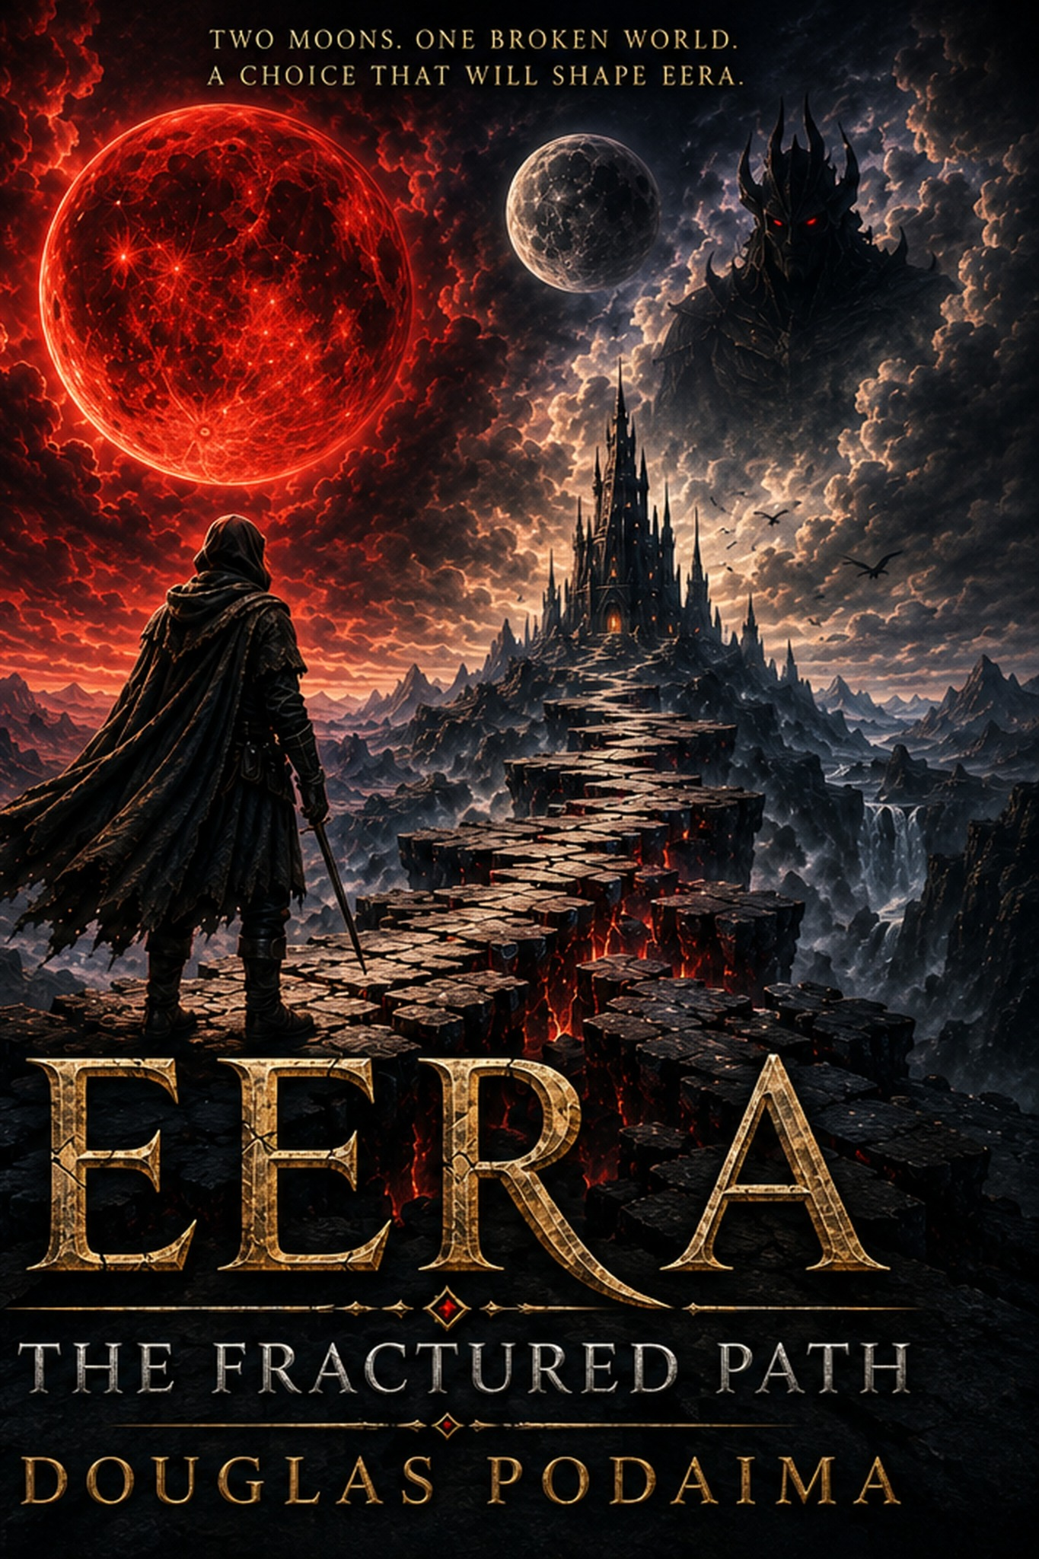
EERA
THE FRACTURED PATH
Two moons. One broken world.
A choice that will shape Eera.
School resources prepared for classroom use:
Student Novel Study
Short Teacher’s Guide
15-slide presentation
Douglas Podaima
Author • Educator • Storyteller
Eera: The Fractured Path • Douglas Podaima • Classroom and school presentation

